Slide 1
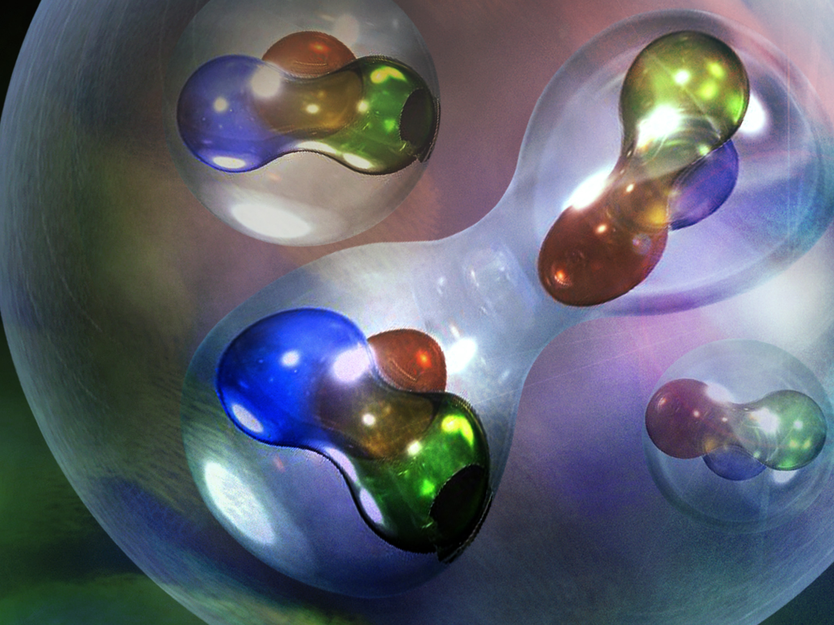
Short-Range Correlation Results from Inclusive Electron Scattering
NOTE: Modern interpretation of the inclusive Results Lean Heavily On Other Reactions
This Does Not Lesson The Importance Of The Inclusive, Just Whole Is Greater Then the Sum Of Parts
by
Presented by
Douglas Higinbotham
Jefferson Lab

Slide 2
Important Acknowledgement:
Several key people who have been working on this topic that couldn’t make it to this meeting and sent me slides and/or had useful discussions with me:
Dr. Burcu Duran
Prof. Nadia Fomin
Dr. Shujie Li
Dr. Dien Nguyen
Dr. Dave Gaskell
Dr. John Arrington
and almost Dr. Casey Morean
My apologies to anyone I forgot to list!

Slide 3
(e,e’p) Electron Scattering Kinematics
p
scattering plane
e'
θ_{pq}
reaction plane
e
(ω,q)
p_{A–1}
φ_{x}
“out-of-plane” angle
Four-momentum transfer: Q² ≡ – q_{μ}q ^{μ} = q² –ω ²
Missing momentum: p_{m} = q – p = p_{A–1}
Energy Transfer: ω = e – e’
Bjorken x: x_{B} = Q²/2mω (determined by kinematics)

Slide 4
(e,e’ ) Electron Scattering Kinematics
scattering plane
e'
e
(ω,q)
Four-momentum transfer: Q² ≡ – q_{μ}q ^{μ} = q² –ω ²
Energy Transfer: ω = e – e’
Bjorken x: x_{B} = Q²/2mω (determined by kinematics)

Slide 5
A(e,e’) at Fixed Q² vs. ω
Elastic
Deep Inelastic
Δ
Quasielastic
N*
Nucleus
ω
Elastic
Δ
Deep Inelastic
N*
Proton
ω

Slide 6
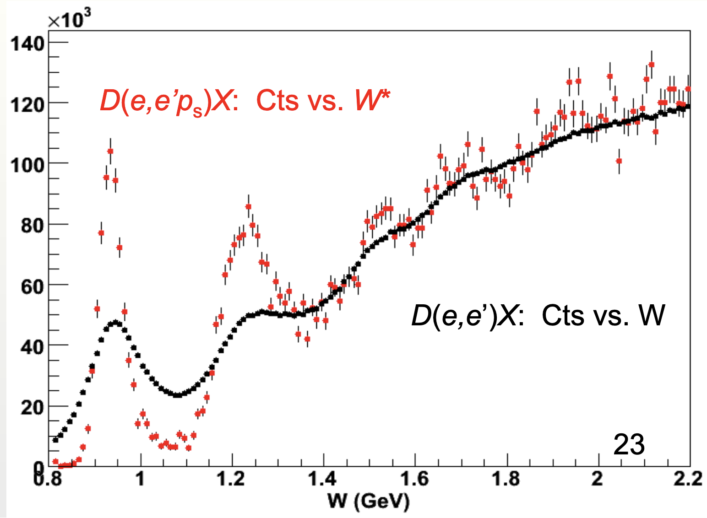
Real Electron Scattering Data
Data from the BONUS Experiment in CLAS / Hall B at Jefferson Lab
6

Slide 7
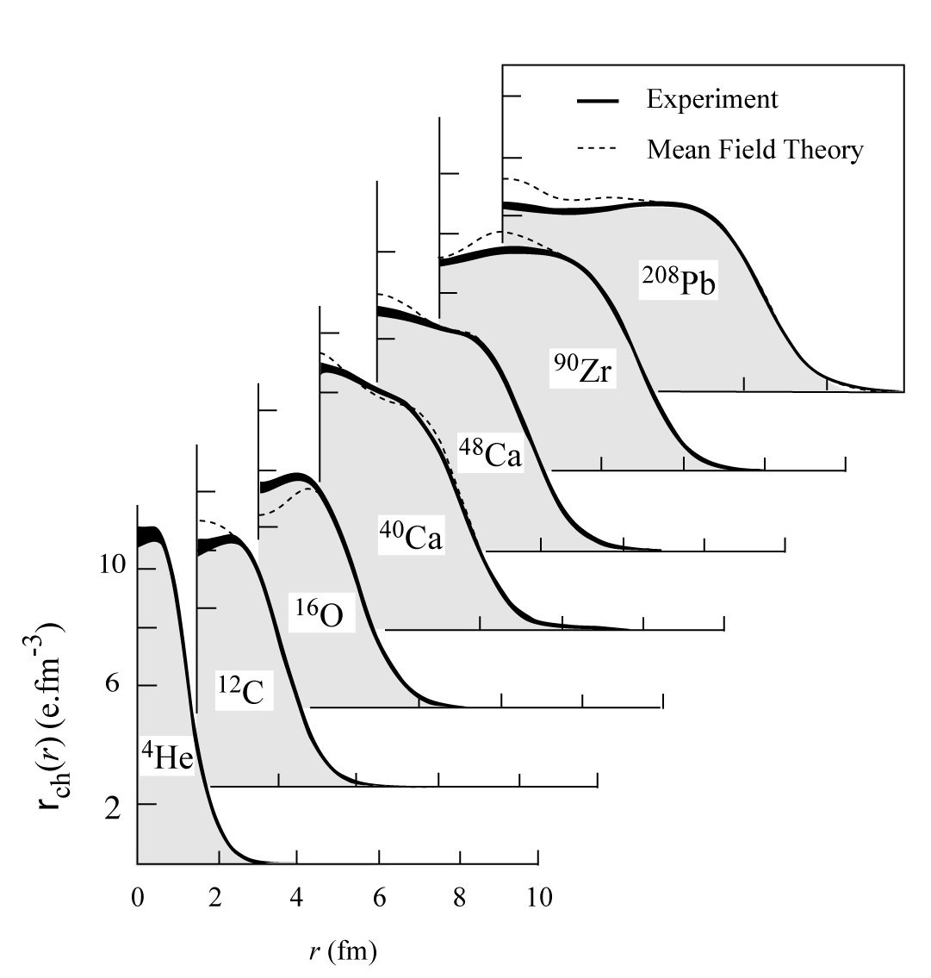
Nuclear Charge Distributions
In ‘70s large data set was acquired on elastic electron scattering (mainly here at Saclay) over large Q²-range and for variety of nuclei.

Slide 8
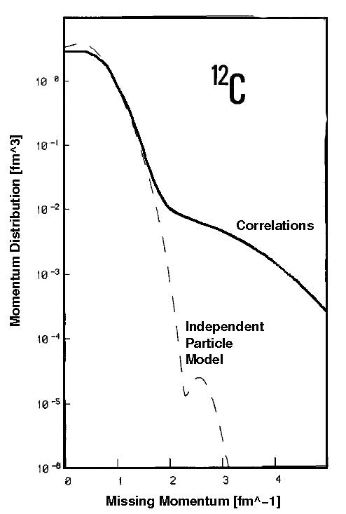
Realistic Momentum Distribution
Benhar et al., Phys. Lett. B 177 (1986) 135.

Slide 9
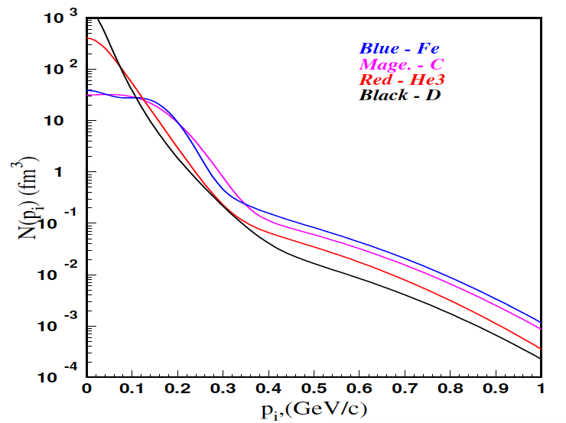
Momentum Distributions
C. Ciofi degli Att and S. Simula, Phys. Rev. C 53 (1996) 1689.
At high initial momentums n_{A}(p) = a_{2n} n_{D}(p)

Slide 10
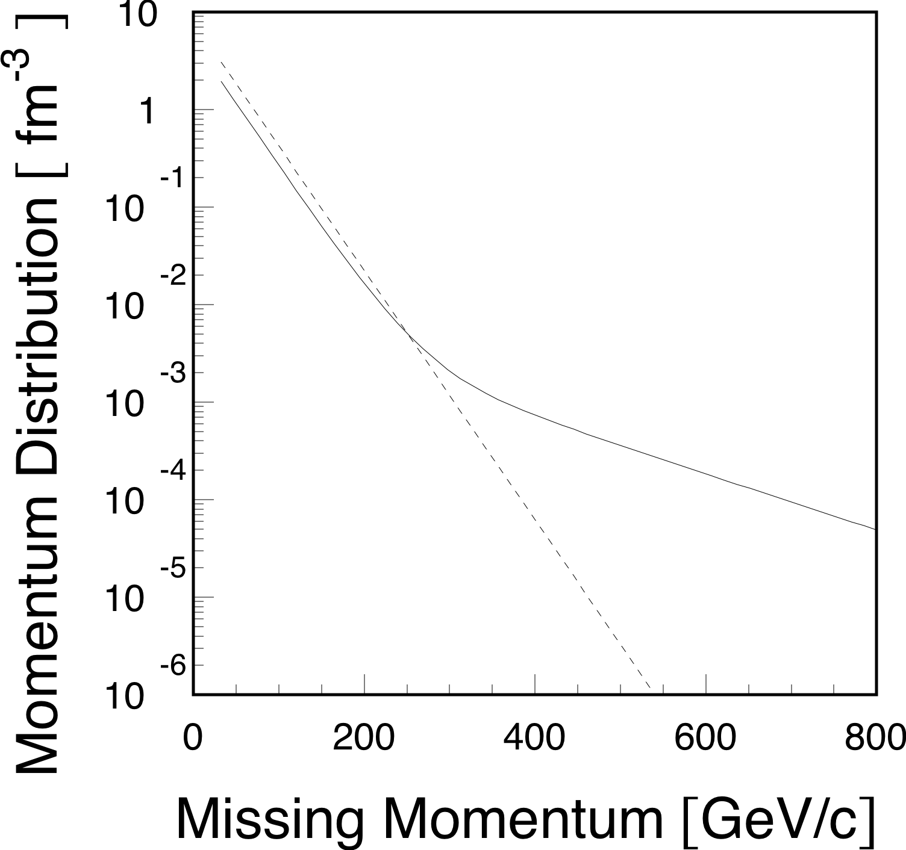
A Toy Model Momentum Distribution
By Uncertainty Principle High Momentum Region Dominated by Short Distance Phenomena

Slide 11
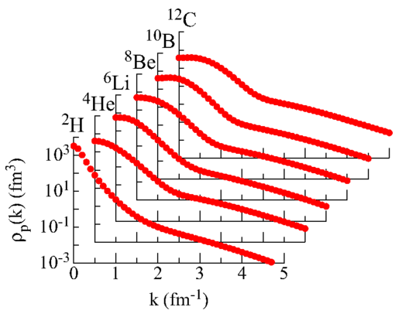
Modern AV18 and Urbana-X Results
R. Wiringa, R. Schiavilla, S. Pieper, and J. Carlson, Phys. Rev. C89 (2014) 024305.
11

Slide 12
Example of Nuclear Scaling Plateaus
K. Sh. Egiyan et al., Phys. Rev. C 68 (2003) 014313.
Originally done with SLAC data by D.B. Day et al., Phys. Rev. C 48 (1993) 2451-2461.
These two papers are highlighted as Physical Review C 50th Anniversary Milestones

Slide 13
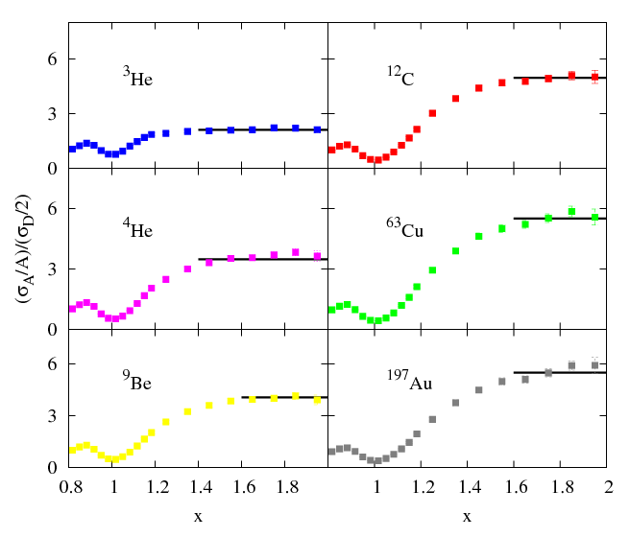
6 GeV Jlab Results From Hall-C
N. Fomin et. al, Phys. Rev. Lett. 108 (2012) 092502.
Q²=2.5 [GeV/c]²

Slide 14
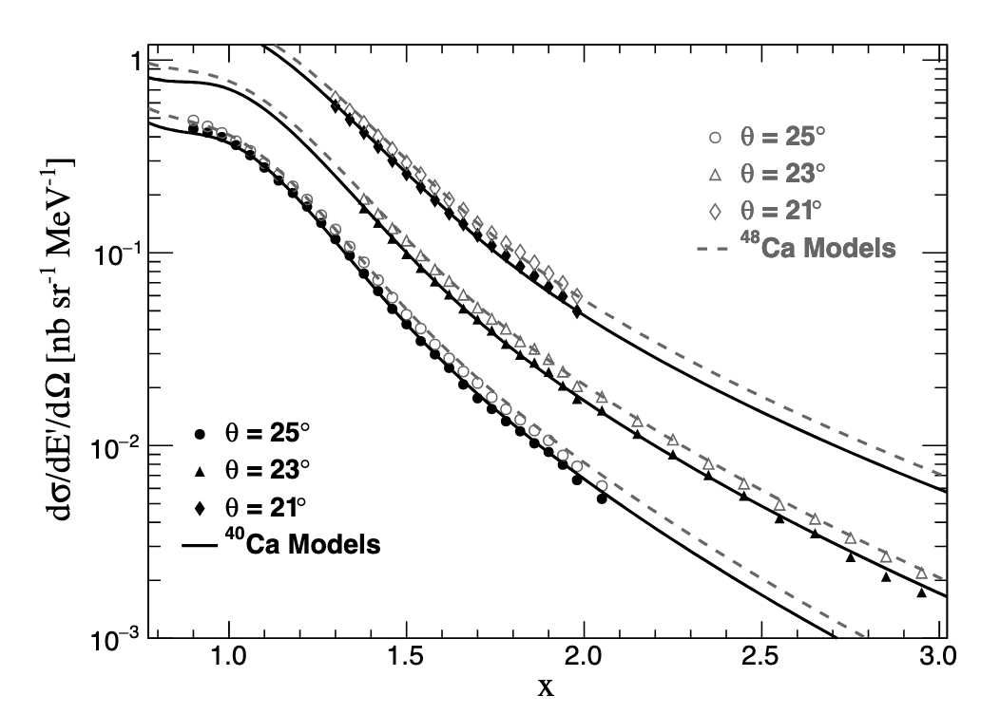
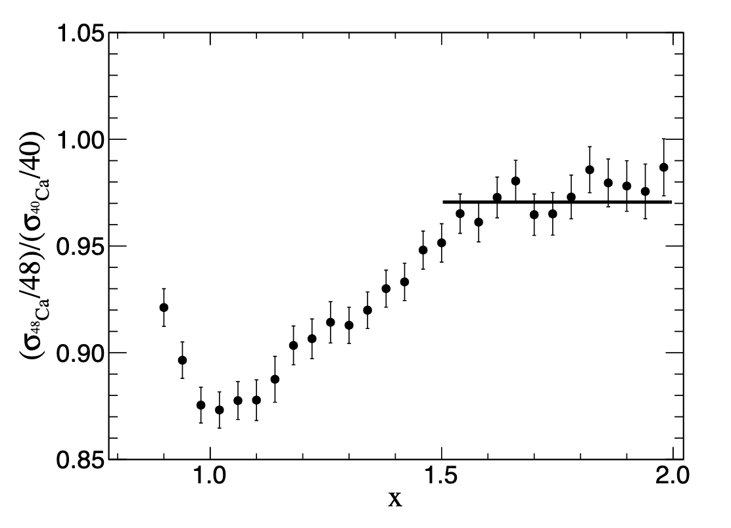
Measurement of ⁴⁰Ca and ⁴⁸Ca
D. Nguyen et al., Phys.Rev.C 102 (2020) 064004
NOTE: It was noted in this work that of the 3H/3He ratio would be 0.75 for isospin independence and 1 for np dominance.

Slide 15
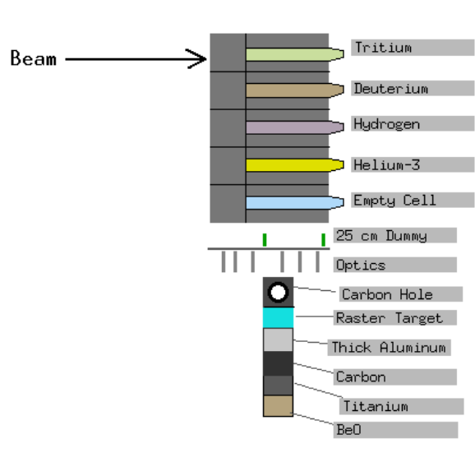
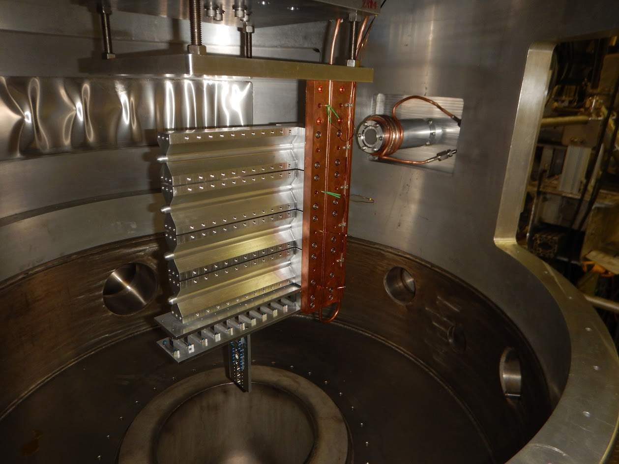
Hall A Tritium Gas Target System
Hall A target GUI
Notes:
Tritium cell is missing in the picture. It was stored in a special designed container until we were ready to get beam

Slide 16
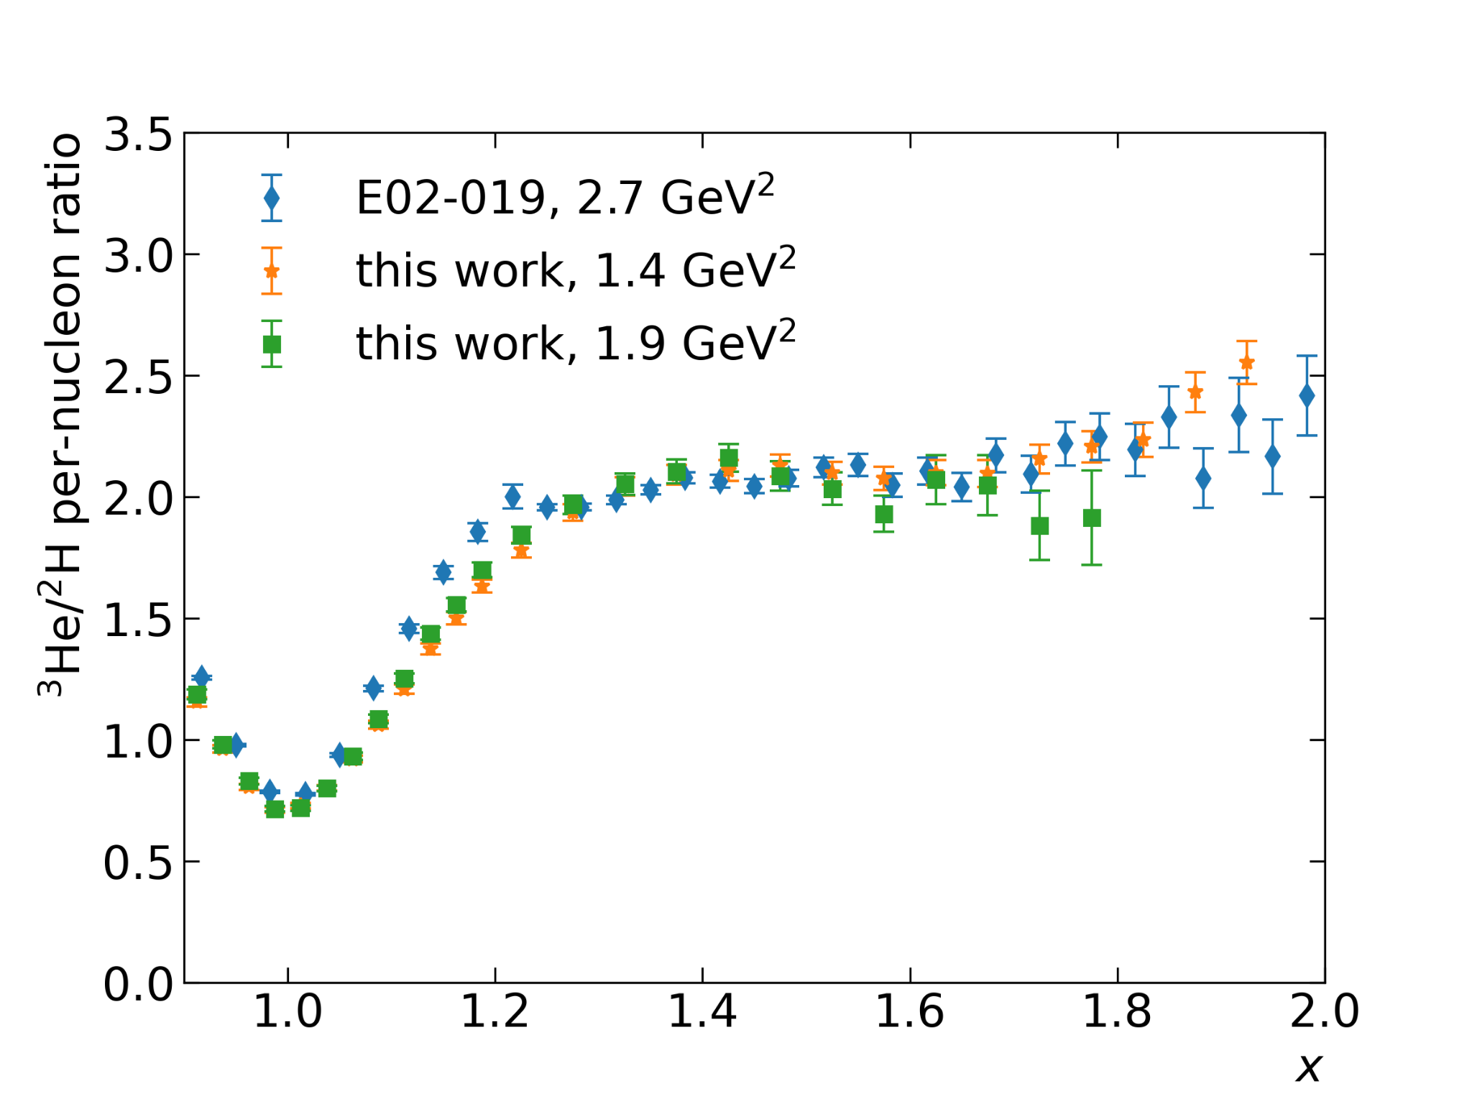
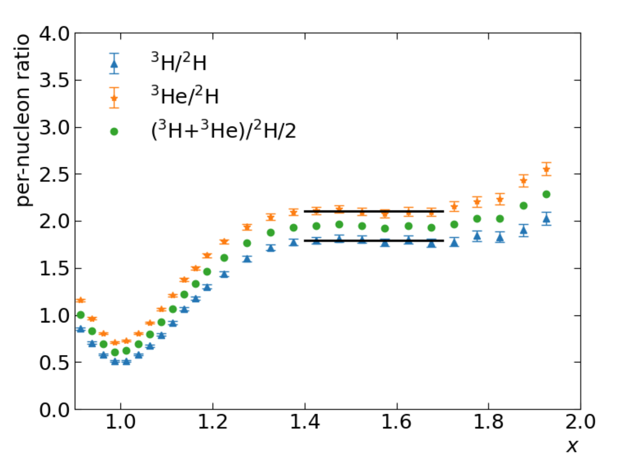
Plateaus in A/D ratios
will be combined with MARATHON EMC results to study EMC-SRC relation
Yield ratio to cancel systematic uncertainties!
E02-019 data from N. Fomin et. al, Phys. Rev. Lett. 108 (2012) 092502.

Slide 17
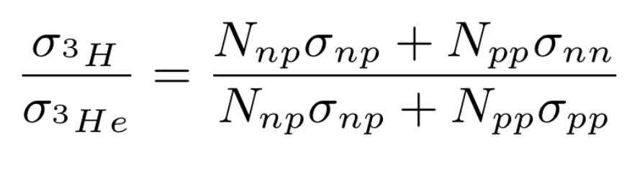

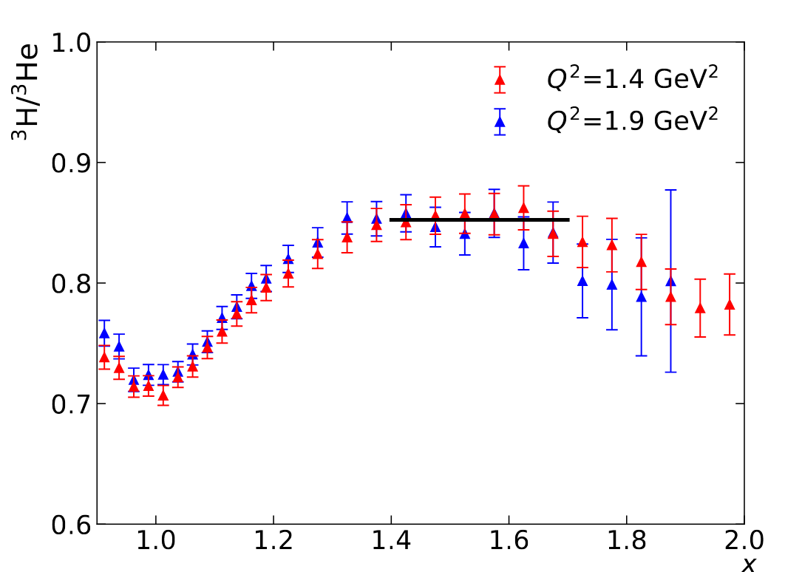
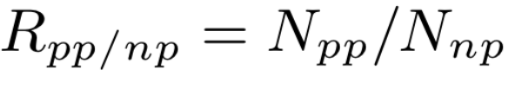
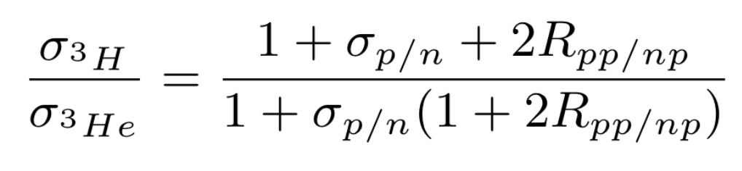
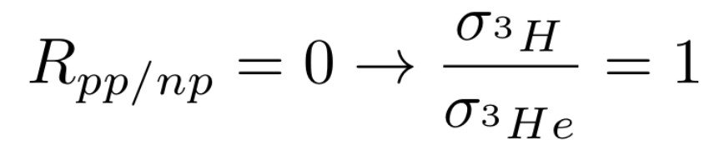
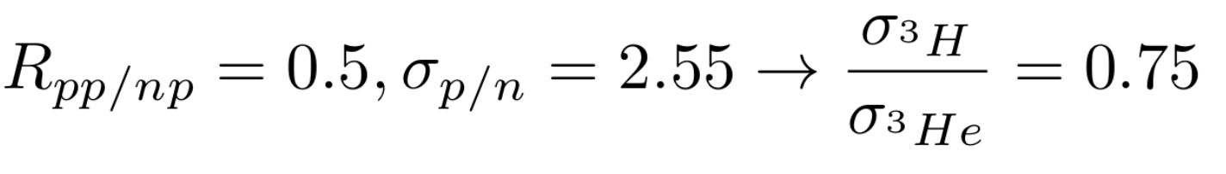
Extract np/pp SRC Fraction From 3H/3He Ratio
S. Li et al., Nature 609 (2022) 41–45.
Offshell elastic xsection (de Forest “cc1”)
number of pp to np pairs ratio （Assume the same in tritium and helium-3)
0.85+-0.01
if np dominance:
if no isospin preference:
1 pp and 2 np pairs in He3 from pair counting
This result implies a complex structure in the high-momentum wavefunction of 3H & 3He.
Notes:
]

Slide 18
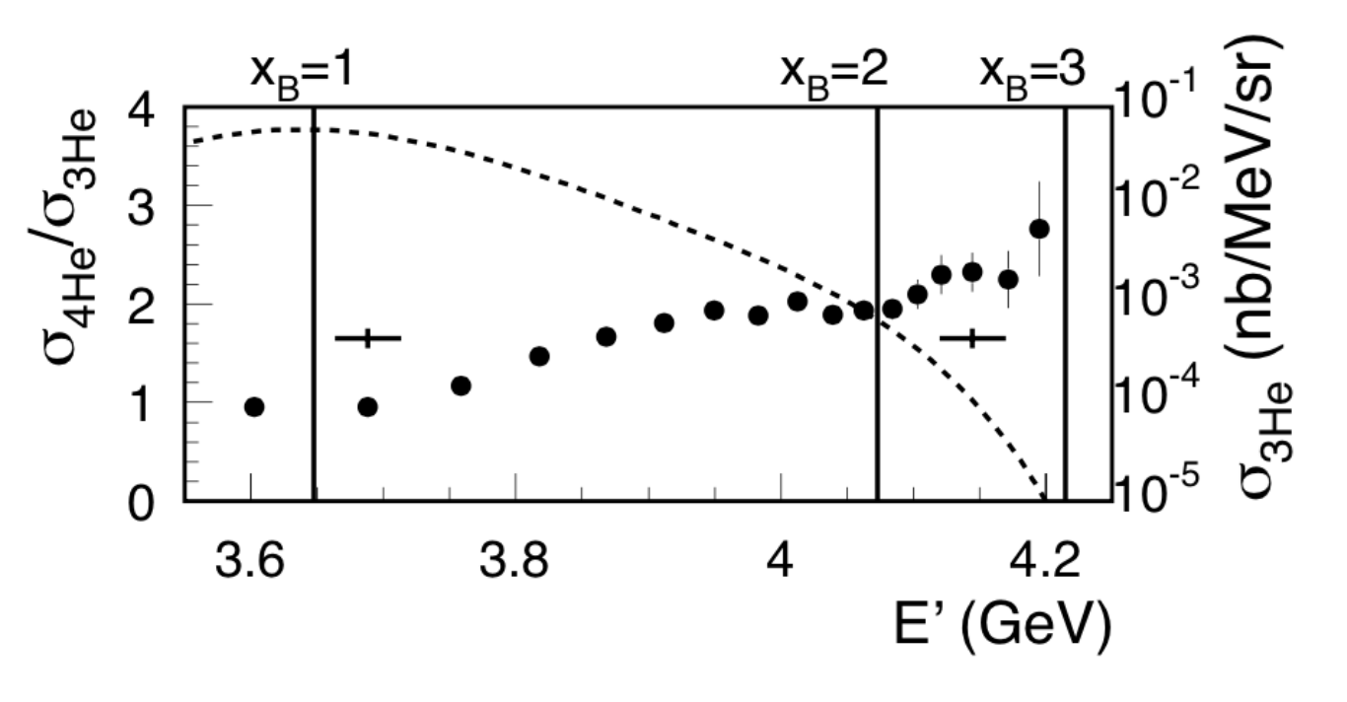
Three Nucleon Correlations (not yet)
DH and Or Hen, Phys. Rev. Lett. 114 (2015) 16, 169201.
( this was truly a PRL where from just checking a result on the back of an envelope )
New High Q2, x>2 data being taken in Hall C right now.
Donal B. Day, Leonid L. Frankfurt, Misak M. Sargsian, Mark I. Strikman, Phys.Rev.C 107 (2023) 014319
Shows we should use alpha 3N instead of x_{B} and predicts the new data should see 3N plateaus.

Slide 20
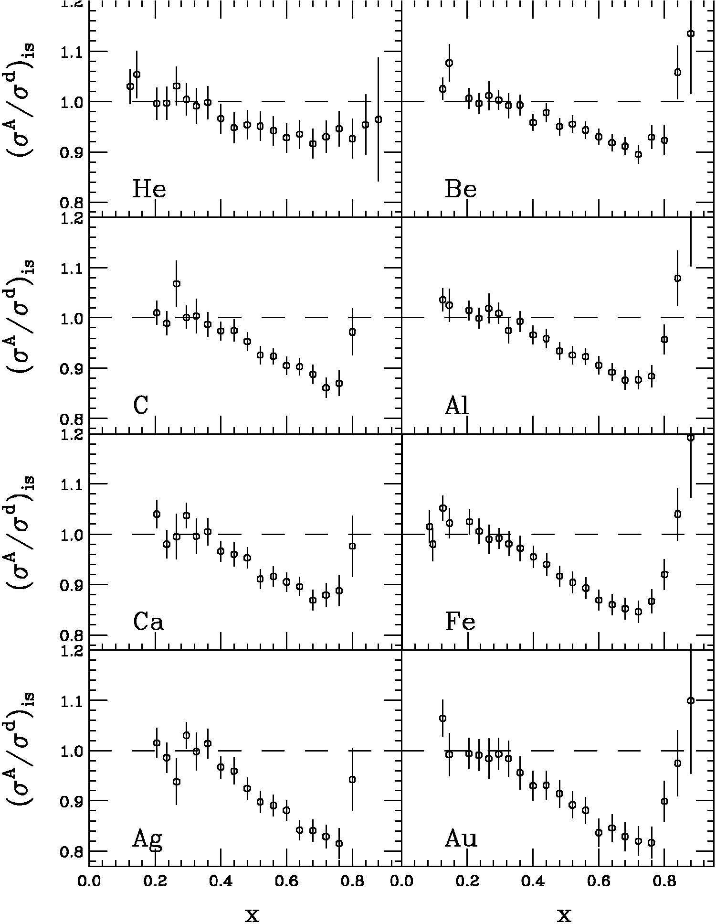
The EMC Effect
EMC effect is simply the fact the ratio of DIS inclusive cross sections is not one
J.J. Aubert et al. PLB 123 (1983) 275.
Simple Parton Counting Expects One
MANY Explanations
SLAC E139
J. Gomez et al., PRD 49 (1994) 4348.
Precise large-x data
Nuclei from A=4 to 197
Conclusions from SLAC data
Q²-independent
Universal x-dependence (shape)
Magnitude varies with A
Average Nuclear Density Effect

Slide 21
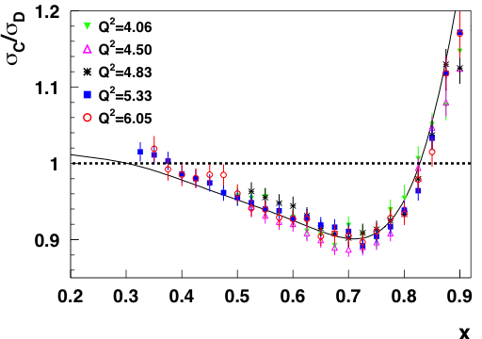
New Jefferson Lab EMC Effect Data
J. Seely et al., Phys, Rev. Lett. 103 (2009) 202301.

Slide 22
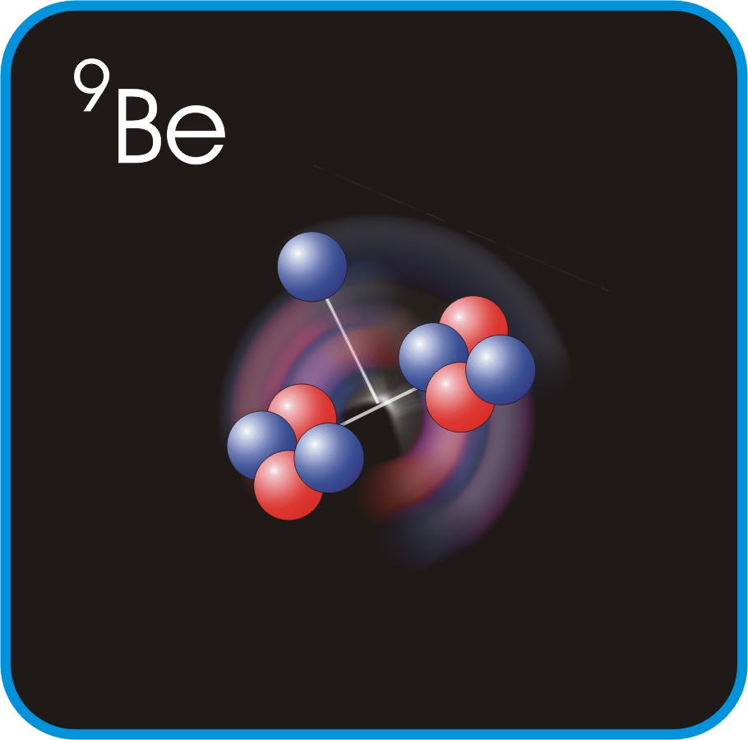
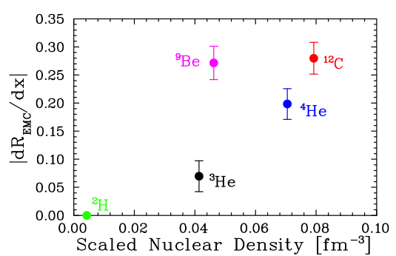
New Jefferson Lab EMC Effect Data
J. Seely et al., Phys, Rev. Lett. 103 (2009) 202301.
Plot shows slope of ratio σA/σD at EMC region.
EMC effect correlated with local density not average density.

Slide 23
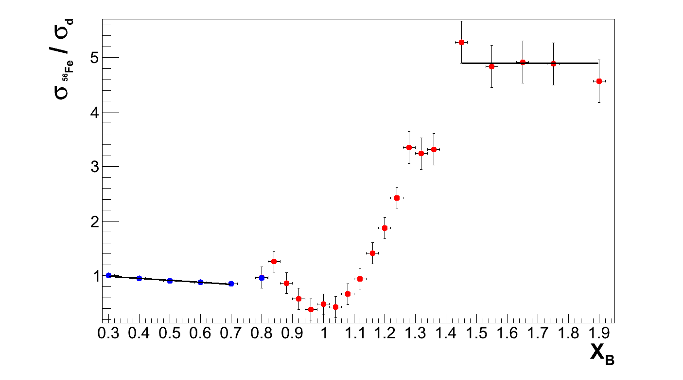
Holistic View of the EMC & SRC Data
D. Higinbotham et al., arXiv:1003.4497.
Q² = 2.5 [GeV/c]²
a_{2N}
dR_{EMC}/dx
Scaling plateaus (a_{2N}) are due to proton-nucleon local density correlations
R. Subedi et al., Science 320 (2008) 1476-1478.
So are the EMC slopes (x_{B}<0.7) and a_{2N} (x_{B}>1.5) correlated?!

Slide 24


But “Nuclear” x_{B} > 1 Results Having Nothing To Do With “Deep Inelastic” x_{B} < 1 EMC Effect Results; that would be like comparing ducks and beavers!!

Slide 25
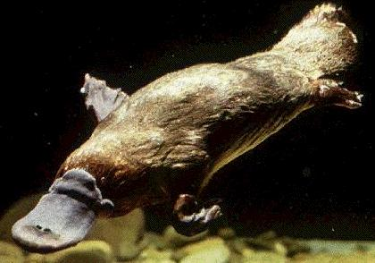
“When the explore returned from Australia, the good people of England, having seen all the animals in the world, demanded to know if it was a duck or a beaver. They were asking the wrong question!” – Rolf G. Winter, Introduction to Quantum Physics

Slide 26
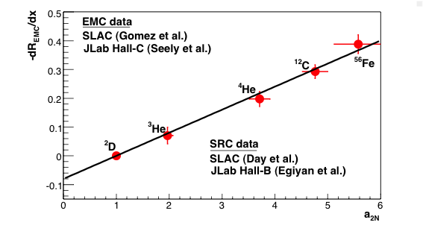
SRC and EMC Correlation
L. Weinstein et al., Phys. Rev. Lett. 106 (2011) 052301.

Slide 27
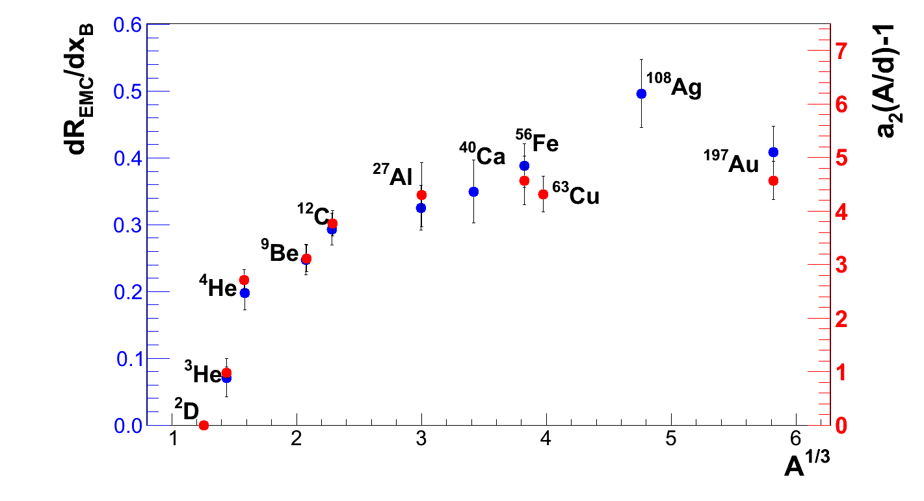
EMC Slopes & SRC Plateaus

Slide 28
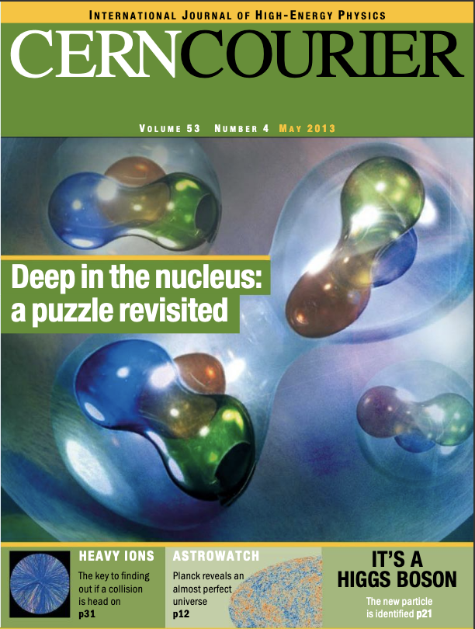
The EMC effect still puzzles after 30 years ( now 40 years )
DH, Gerald A Miller, Or Hen, and Klaus Rith, CERN Cour. 53N4 (2013), 24

Slide 29
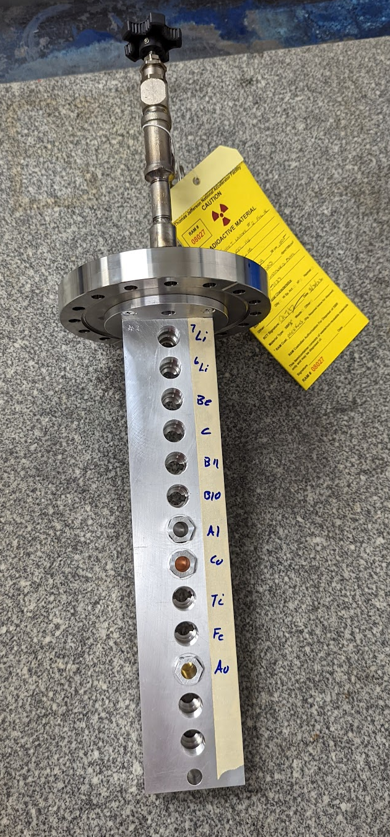
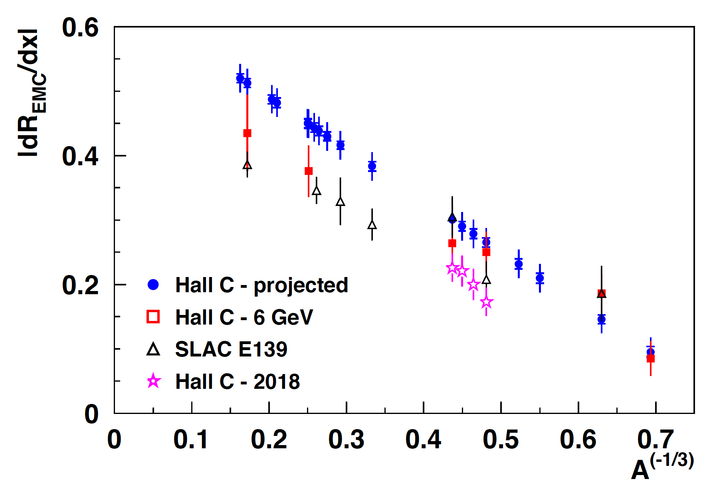
More Data Being Taken Right Now! EMC, E12-10-008 and x>1, E12-06-105)
With thanks to Dave Meekins for his new solid target ladder!

Slide 30
Summary
Inclusive Election Scattering Data Having Provided Both Valuable Insights As Well As Amazing Puzzles
As I Think Will Become Very Clear, True Insight Comes From Making Use Of Multiple Reactions To Truly Gain Insights Into The Nucleus
New Inclusive EMC (x<1) and SRC (x>1) Experiments Running RIGHT NOW with 12GeV Jefferson Lab
In the future, we 2nd generation ³H & ³He with CLAS12
Looking to further future (discussions on Thursday):
Upgrade the dump in Hall A and/or C to 2 MW instead of 1 MW
Upgrade the energy reach of JLab to 22 GeV ( circa 2040 )

Slide 31
So the good experimentalists and theorists finally agreed it wasn’t just protons and a neutrons. It was a nucleus!

